Slide 1
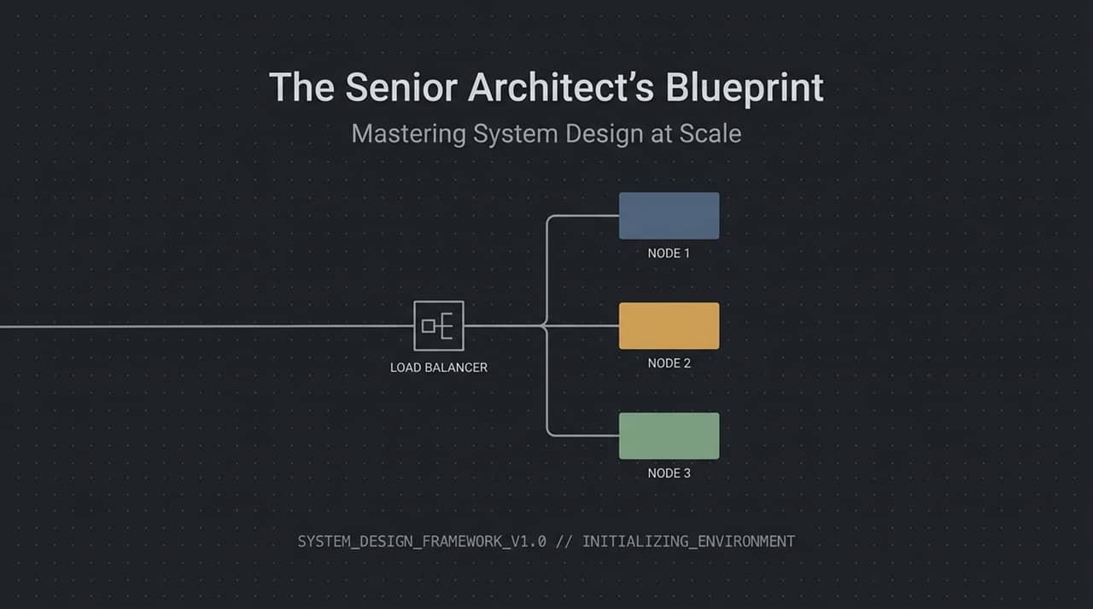
Notes:
Welcome everyone. Today we are diving into The Senior Architect’s Blueprint: Mastering System Design at Scale.
System design has become the primary differentiator for mid-level, senior, and staff-level engineering roles. In an era where AI tools can auto-generate code snippets and routine syntax in seconds, engineering interviews and technical leadership discussions have fundamentally shifted. Companies are no longer evaluating you solely on whether you can write code; they want to know if you understand the big picture.
Can you design high-availability, fault-tolerant architectures from scratch? Can you explain how components communicate under intense load? And most importantly, can you navigate technical trade-offs when there is no single 'correct' answer?
Over the course of this presentation, we will walk through a concrete, repeatable 5-step framework. We'll apply it across three distinct system archetypes—ranging from heavy media streaming platforms like Spotify, to hyper-precise transaction engines like Booking.com, to real-time, low-latency messaging platforms like WhatsApp. Let’s get started.
https://www.youtube.com/watch?v=vOn6wUcOXzI

Slide 2
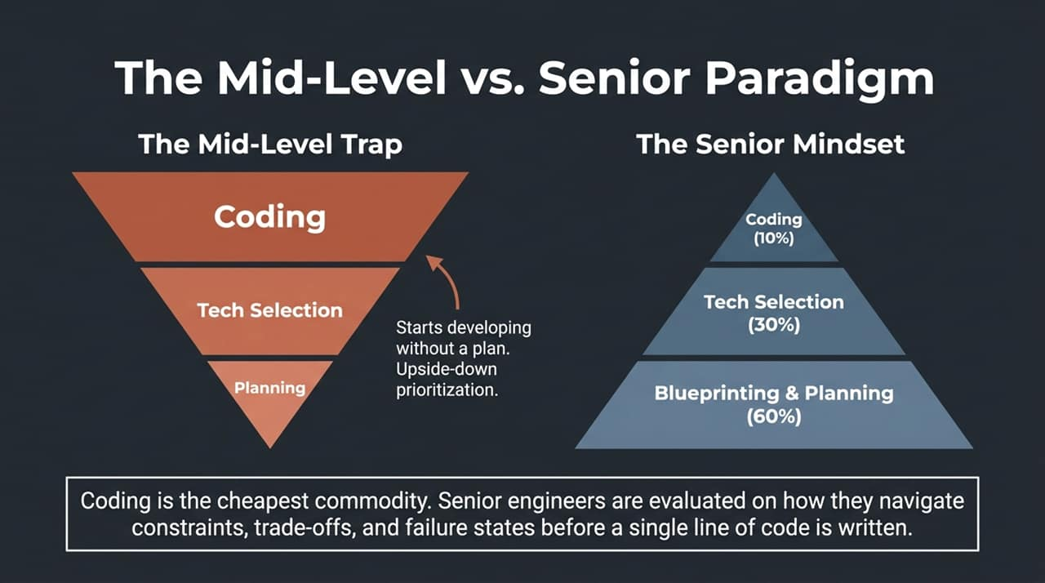
Notes:
Let's start by dissecting the fundamental shift between a mid-level mindset and a senior architectural mindset.
On the left, you see 'The Mid-Level Trap'. Mid-level developers often fall into upside-down prioritization. When handed a complex problem, their immediate instinct is to start coding immediately or pick their favorite shiny technology stack. They attempt to build without a blueprint. In a system design interview or production environment, this leads to hitting structural dead ends.
Now, contrast that with 'The Senior Mindset' on the right. Senior engineers recognize that coding is the cheapest commodity. Only about 10% of your value at a senior or staff level lies in writing the raw lines of code. 30% goes toward tech selection—choosing the right tool for the job based on hard data.
A full 60% of senior impact happens in blueprinting and planning before a single line of code is written. You are evaluated on how you navigate non-functional constraints, evaluate trade-offs, and design failure modes. If you can catch single points of failure on a whiteboard, you save your organization months of engineering rework in production.

Slide 3
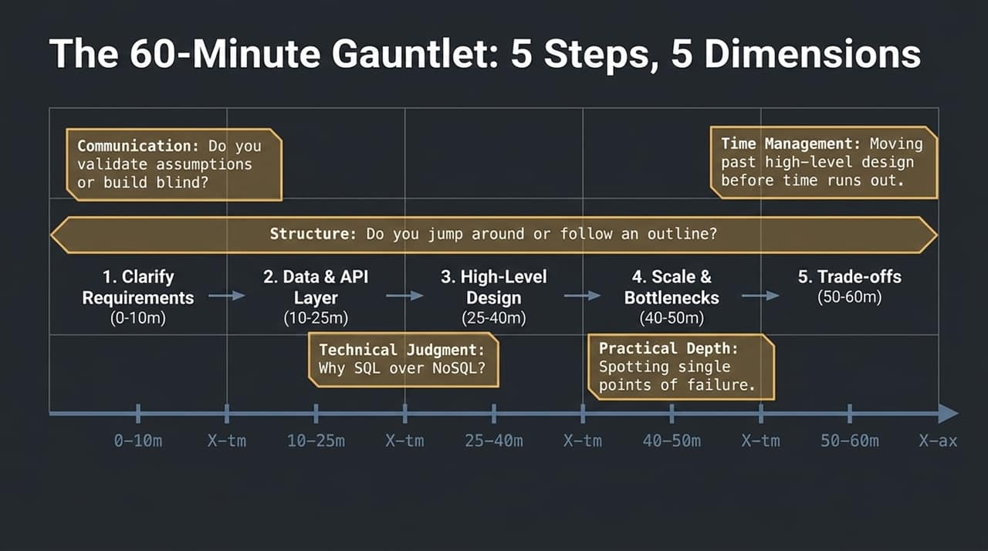
Notes:
When you enter a 60-minute system design interview, you are given an intentionally ambiguous prompt like 'Design Spotify' or 'Design WhatsApp'. To succeed, you must execute a structured, time-managed framework across 5 distinct steps:
Clarify Requirements (0–10m): Validate assumptions instead of building blind. Establish functional scope and lock down non-functional constraints like Daily Active Users (DAU), write/read throughput, and latency SLA targets.
Data & API Layer (10–25m): Demonstrate technical judgment. Define data schemas, key endpoints, and explain why you chose a specific database paradigm (e.g., SQL vs. NoSQL).
High-Level Design (25–40m): Map end-to-end data flow. Connect clients, API gateways, load balancers, application servers, and storage engines.
Scale & Bottlenecks (40–50m): Demonstrate practical depth. Spot single points of failure (SPOFs), address hot keys, and implement caching strategies.
Trade-offs (50–60m): Own your architectural sacrifices. Explain CAP theorem compromises and cost implications.
Throughout this hour, interviewers score you across 5 dimensions: Communication, Structure, Technical Judgment, Practical Depth, and Time Management. Stay organized and keep the conversation collaborative.

Slide 4
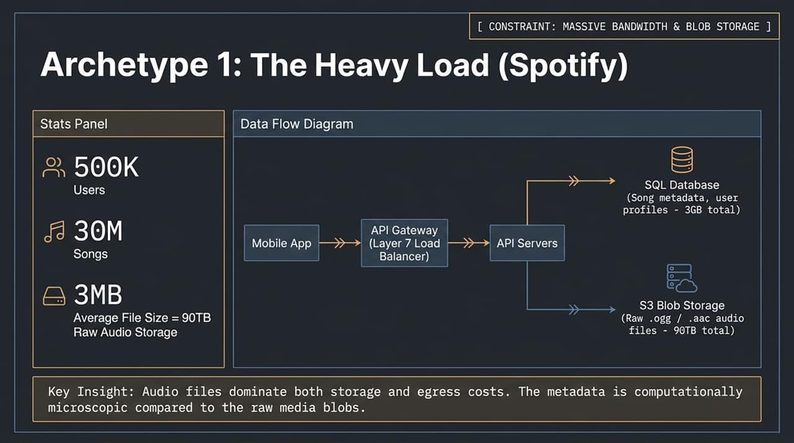
Notes:
Let's apply our framework to Archetype 1: The Heavy Load, modeled after Spotify.
The defining core constraint here is Massive Bandwidth & Blob Storage. Let's analyze the scale numbers: Imagine supporting 500,000 active users and a catalog of 30 million songs. At an average file size of 3MB per song, raw audio files demand 90 Terabytes of media storage.
However, look at the contrast in the data flow diagram:
Metadata (Song details, user profiles, playlists): Total metadata size is roughly 3GB—computationally microscopic and easily manageable within a relational SQL database.
Raw Media (.ogg / .aac audio files): Accounts for the entire 90TB payload.
Key Architectural Insight: Audio media files dominate both storage costs and egress bandwidth. Your architecture must strictly segregate metadata operations from heavy binary data operations.

Slide 5
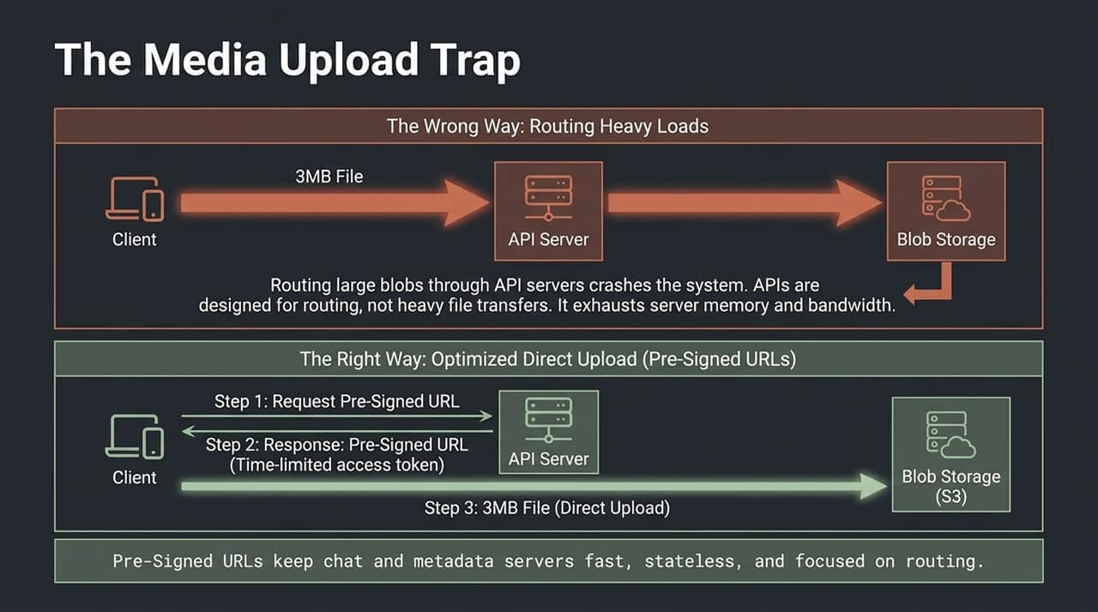
Notes:
A classic rookie mistake in system design interviews is illustrated at the top of this slide: The Media Upload Trap.
The Wrong Way: The client streams a 3MB audio binary file directly to an API Server, which then forwards that file to Blob Storage. API servers are optimized for lightweight JSON routing, business logic execution, and database queries. Passing large binary payloads through application servers exhausts network bandwidth, causes memory spikes, bloats thread pools, and eventually crashes the application layer under scale.
The Right Way (Optimized Direct Upload):
Step 1: The client issues a lightweight request to the API Server for an upload authorization token.
Step 2: The API Server generates and returns a Pre-Signed URL—a time-limited, cryptographically secured access token.
Step 3: The client uploads the 3MB binary file directly to S3 Blob Storage using the Pre-Signed URL.
This architectural pattern decouples media transfer from core APIs, ensuring your API servers remain fast, stateless, and focused exclusively on light metadata routing.

Slide 6
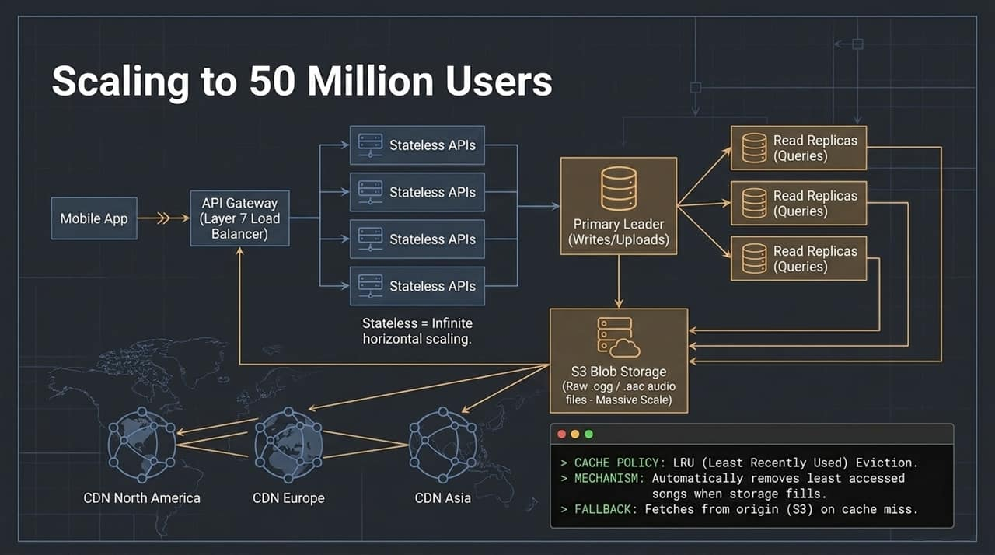
Notes:
Now let's scale this architecture up to serve 50 million active users.
Stateless API Layer: We place a Layer 7 Load Balancer at the front, routing traffic via Round-Robin or Least-Connection algorithms across horizontally scalable, stateless API nodes. Since APIs hold no session state, we can instantly add or remove instances based on request spikes.
Database Read/Write Segregation: We utilize a primary Primary Leader SQL instance to handle write operations (such as new song uploads or user registration). Read-only queries are offloaded across distributed Read Replicas.
Global Edge Delivery (CDNs): To prevent global network latency when streaming audio, audio files are distributed across regional Content Delivery Networks (CDNs) in North America, Europe, and Asia.
Caching Policy: CDNs operate under an LRU (Least Recently Used) Eviction Policy. Popular tracks are cached near the edge for instant playback, while less frequent tracks miss to origin S3 storage, keeping overall egress costs low.

Slide 7
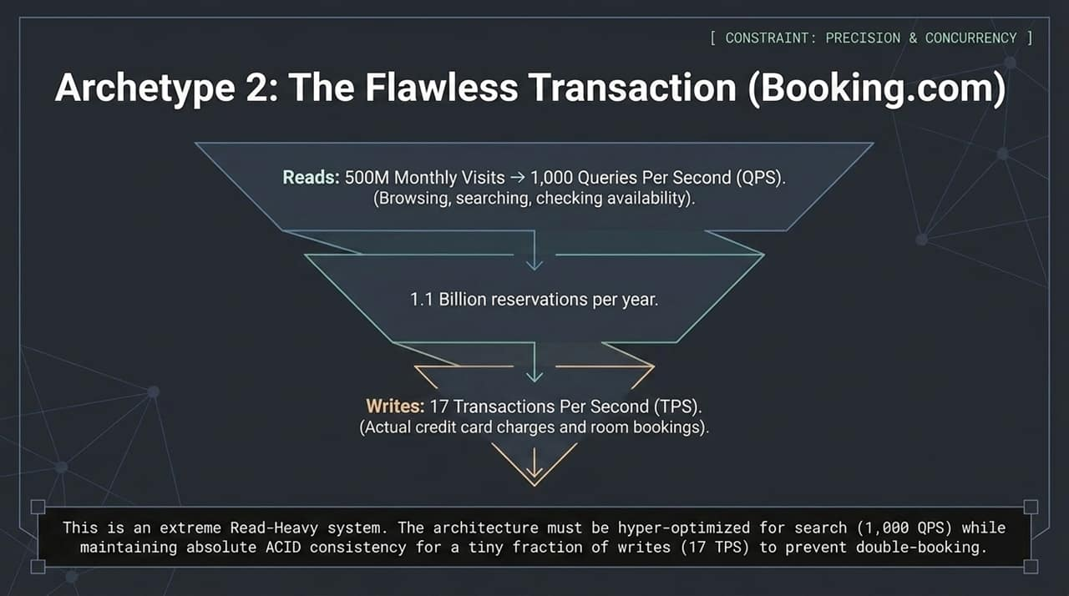
Notes:
Let's pivot to Archetype 2: The Flawless Transaction, modeled after platforms like Booking.com.
The core constraints here are Precision and Concurrency. Notice the extreme asymmetry between reads and writes:
Read Load: 500 million monthly visits generating approximately 1,000 Queries Per Second (QPS). Users constantly search, browse rooms, apply filters, and check pricing.
Write Load: 1.1 billion reservations per year, translating to an average of just 17 Transactions Per Second (TPS).
While 17 TPS sounds low, the stakes are exceptionally high. A single double-booking incident ruins customer trust and incurs immediate financial penalties. Therefore, our architecture must be hyper-optimized for rapid search at 1,000 QPS, while guaranteeing absolute ACID transactional consistency for writes.

Slide 8
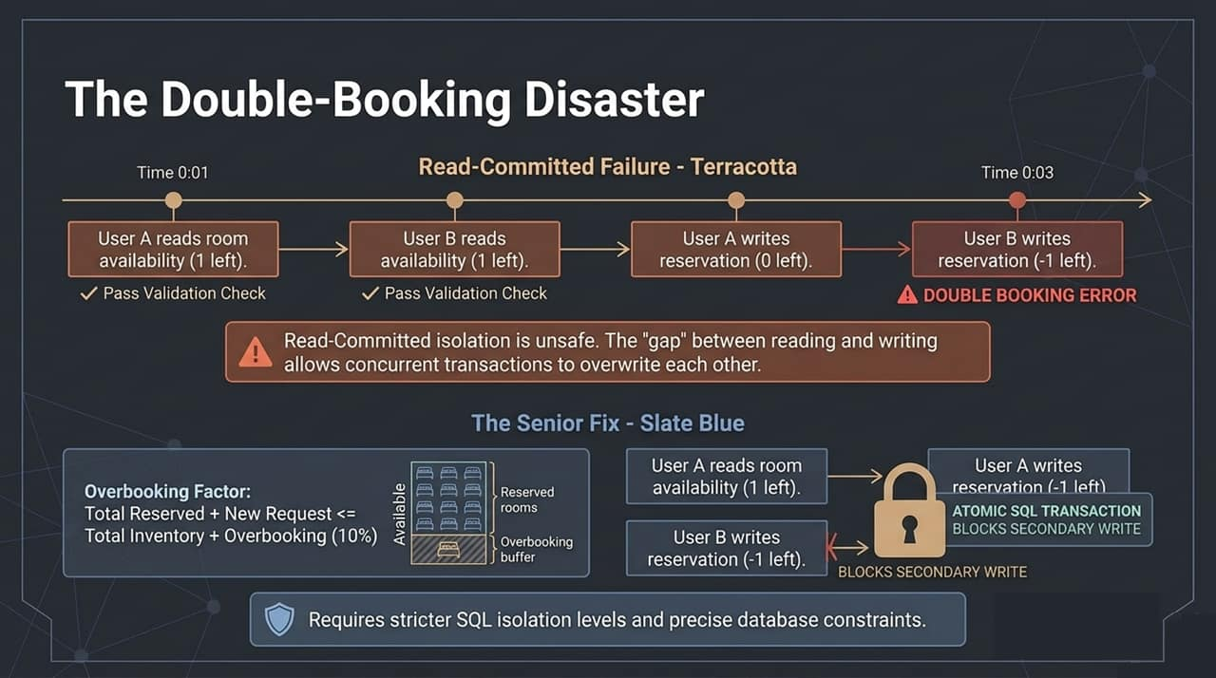
Notes:
Let's analyze why naive database isolation causes catastrophic business failures in reservation systems.
Look at the top timeline: Read-Committed Isolation Failure.
At time 0:01, User A checks room availability (1 room left) and passes validation.
Simultaneously, User B checks availability, sees the same 1 room left, and passes validation.
At 0:03, User A executes a reservation, dropping inventory to 0.
Milliseconds later, User B executes a reservation, dropping inventory to -1. Double-booking error.
The Senior Fix: We must move beyond weak isolation levels. We enforce Atomic SQL Transactions combined with explicit pessimistic row locks (SELECT ... FOR UPDATE) or strict serializable isolation levels. When User A initiates a booking attempt, the database locks the specific inventory record. User B’s write attempt is blocked until User A's transaction completes.
Additionally, high-scale platforms implement an Overbooking Buffer (typically 10%), ensuring total reservations never exceed defined capacity bounds: $\text{Total} \text{Reserved}+\text{New} \text{Request}≤\text{Total} \text{Inventory}+\text{Overbooking} \text{Buffer}$.

Slide 9
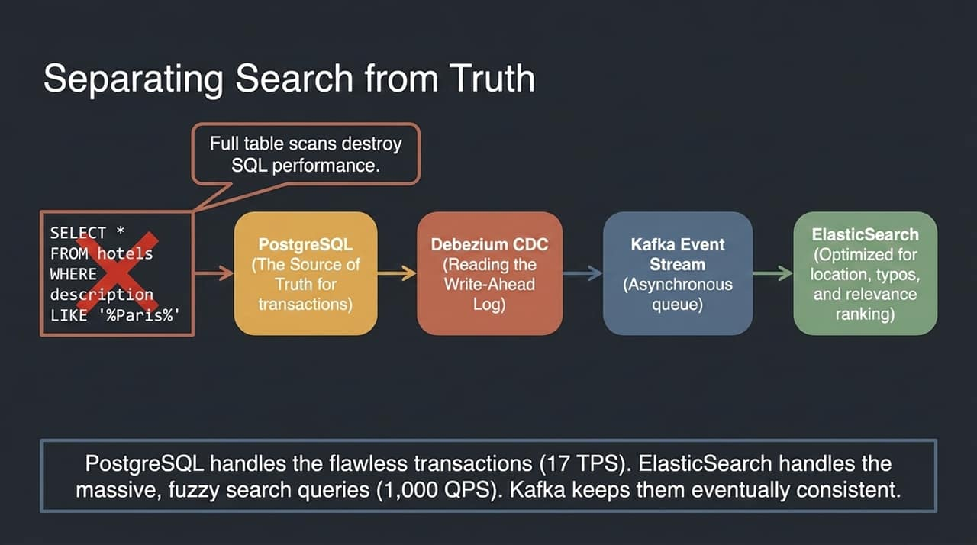
Notes:
How do we handle 1,000 QPS of heavy search traffic without locking up our transactional database?
Running queries like SELECT * FROM hotels WHERE description LIKE '%Paris%' directly against PostgreSQL triggers full table scans, destroying database performance and blocking critical write transactions.
The Solution: Command Query Responsibility Segregation (CQRS).
PostgreSQL serves exclusively as the single Source of Truth for transactional reservation writes (17 TPS).
Debezium CDC (Change Data Capture) monitors PostgreSQL's Write-Ahead Log (WAL) in real-time, streaming row updates instantly.
Kafka Event Stream acts as an asynchronous buffer queue, guaranteeing reliable, ordered delivery of database events.
ElasticSearch ingests those events to power search queries (1,000 QPS), fully optimized for geospatial filtering, typo tolerance, and relevance ranking.
PostgreSQL guarantees flawless consistency, while ElasticSearch handles high-speed searches asynchronously.

Slide 10
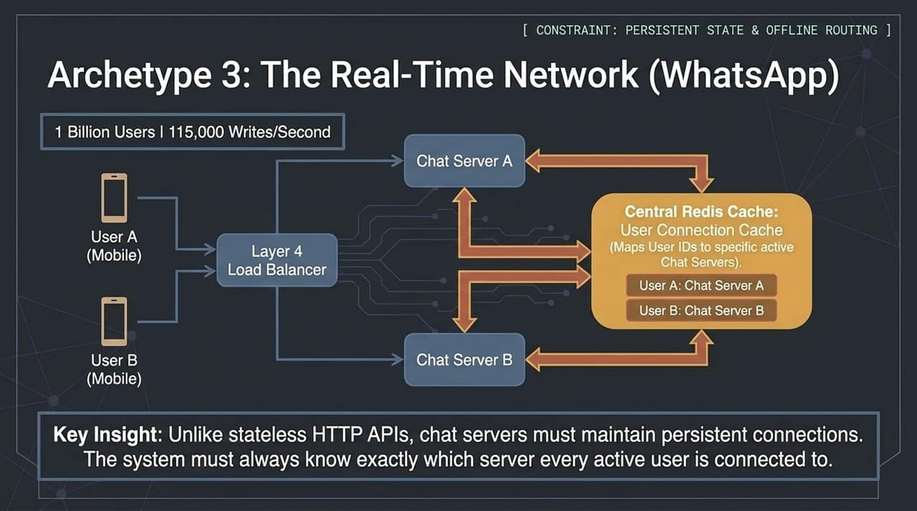
Notes:
Now let's examine Archetype 3: The Real-Time Network, modeled after WhatsApp.
The core constraints here are Persistent State & Offline Routing at massive scale—1 Billion Users executing over 115,000 writes per second.
Unlike stateless HTTP web servers where clients connect, receive data, and disconnect, chat platforms require persistent, long-lived TCP connections.
When User A sends a message to User B, how does Chat Server A know where User B is?
We introduce a Central Redis Connection Cache. This distributed cache maintains an in-memory mapping of active User ID -> Active Chat Server ID. When User A posts a payload, Server A queries Redis, identifies that User B is connected to Chat Server B, and routes the message payload directly over internal network connections instantly.

Slide 11
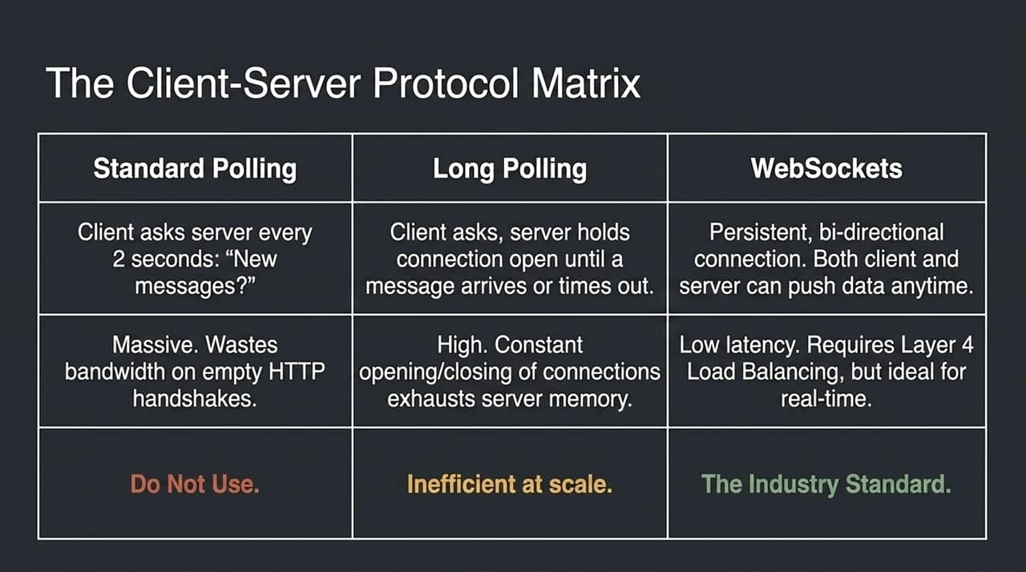
Notes:
Selecting the correct network communication protocol is critical for real-time systems. Let's evaluate the protocol options:
Standard Polling: The client queries the server every 2 seconds asking 'Are there new messages?'. This creates massive network overhead, wasting bandwidth and CPU cycles on empty HTTP headers. Recommendation: Do not use for real-time messaging.
Long Polling: The client opens an HTTP connection and the server holds it open until data arrives or a timeout occurs. While latency is lower, constant connection tear-down and re-establishment under heavy load exhausts server memory. Inefficient at WhatsApp scale.
WebSockets: Establishes a persistent, full-duplex, bi-directional TCP connection. Either client or server can push payloads instantly with minimal frame overhead. It requires Layer 4 Load Balancing (TCP level), but remains the industry standard for real-time interactive communications.

Slide 12
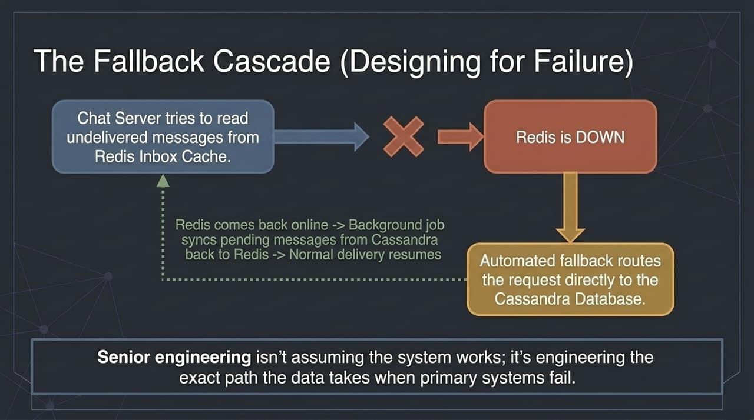
Notes:
Senior architectural capability is defined by how gracefully your system behaves when primary components fail. Let's review The Fallback Cascade.
In our normal messaging flow, undelivered messages reside in a high-speed Redis Inbox Cache. But what happens if the Redis cache cluster crashes under extreme load?
Failure State: The Chat Server attempts to fetch unread messages, but Redis returns a timeout/failure error.
Automated Fallback Route: Instead of returning a 500 error to the client, an automated fallback mechanism reroutes the read query directly to our write-heavy, distributed Cassandra Database persistent layer.
Recovery & Resync: Once the Redis cluster recovers, an asynchronous background sync job drains pending messages from Cassandra back into Redis memory, restoring normal delivery speeds seamlessly.
Senior Philosophy: Do not assume your infrastructure works flawlessly. Engineer explicit fallback paths for every single point of failure.

Slide 13
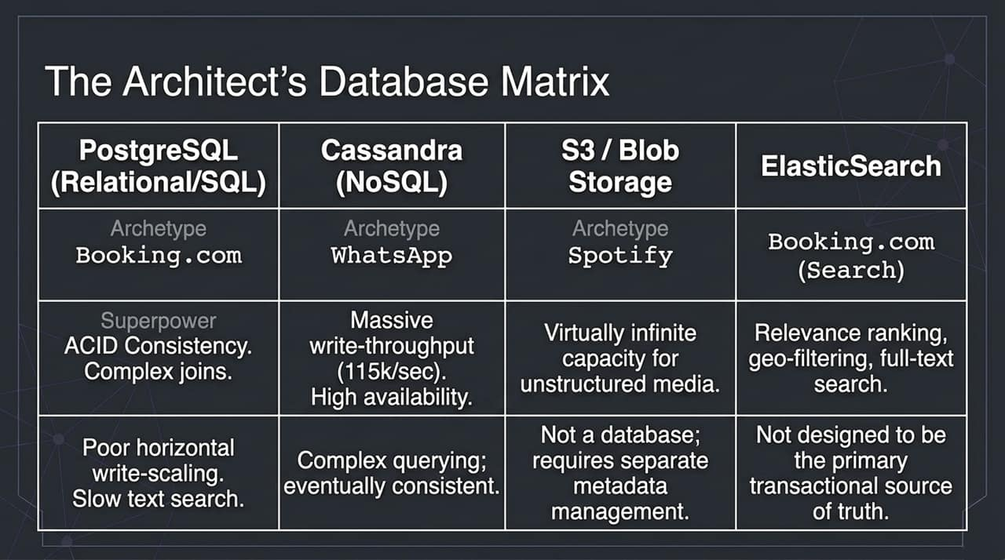
Notes:
To select databases effectively, senior architects rely on a structured decision matrix:
PostgreSQL (Relational/SQL): Superpower: Absolute ACID transaction consistency and complex relational joins. Weakness: Poor horizontal write-scaling capability. Ideal for financial and reservation systems.
Cassandra (NoSQL Column-Family): Superpower: Unrivaled write throughput ($115,000+$ writes/sec) with no single point of failure. Weakness: No support for complex JOINs; eventually consistent. Ideal for chat histories and activity logs.
S3 / Object Storage: Superpower: Unlimited scalability for raw unstructured blobs at low cost. Weakness: High latency; requires external database indexing. Ideal for raw audio, video, and image assets.
ElasticSearch: Superpower: Ultra-fast full-text search, fuzzy matching, and geospatial indexing. Weakness: Expensive cluster management; not suitable as a primary transactional store.

Slide 14
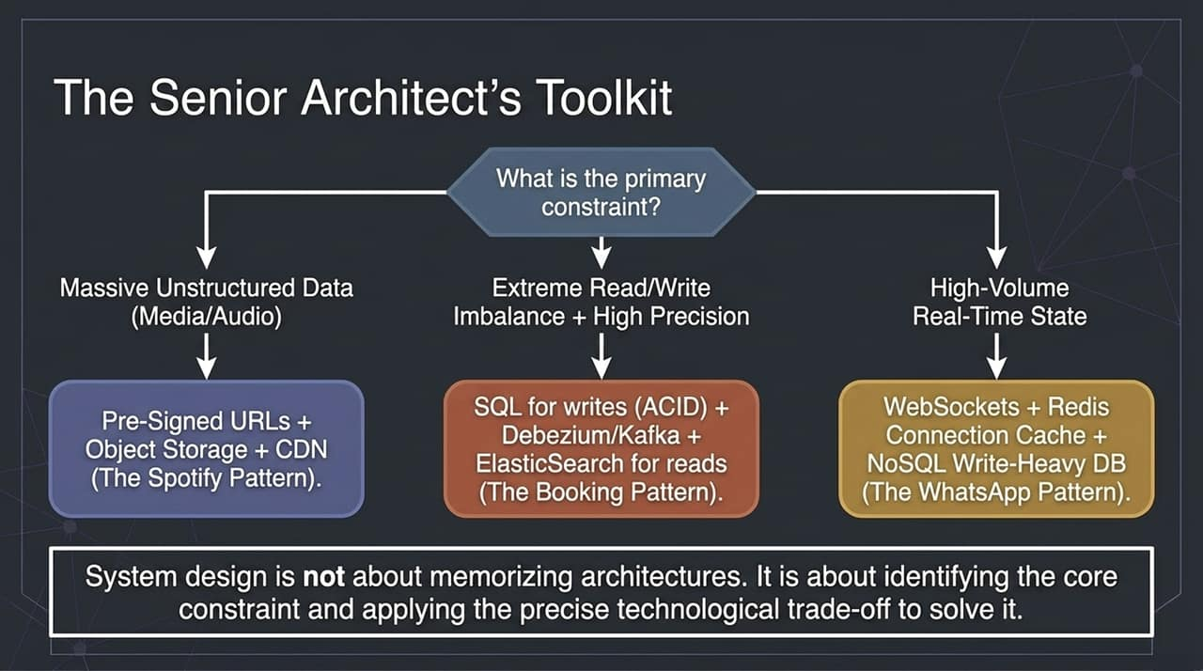
Notes:
Let's synthesize our learnings into a master toolkit. When approaching any high-scale architectural design, immediately isolate the Primary System Constraint:
If your primary constraint is Massive Unstructured Media (Audio/Video): Deploy Pre-Signed URLs + S3 Object Storage + CDN Edge Eviction. (The Spotify Pattern)
If your primary constraint is Read/Write Imbalance with Strict Transactional Precision: Deploy Relational SQL for writes + Change Data Capture (Debezium/Kafka) + ElasticSearch for reads. (The Booking Pattern)
If your primary constraint is High-Volume Real-Time State: Deploy WebSockets + Redis Connection Mapping + NoSQL Write-Heavy persistent storage. (The WhatsApp Pattern)
System design isn't about memorizing complex static diagrams. It is about identifying core constraints and executing precise architectural trade-offs to solve them.

Slide 15
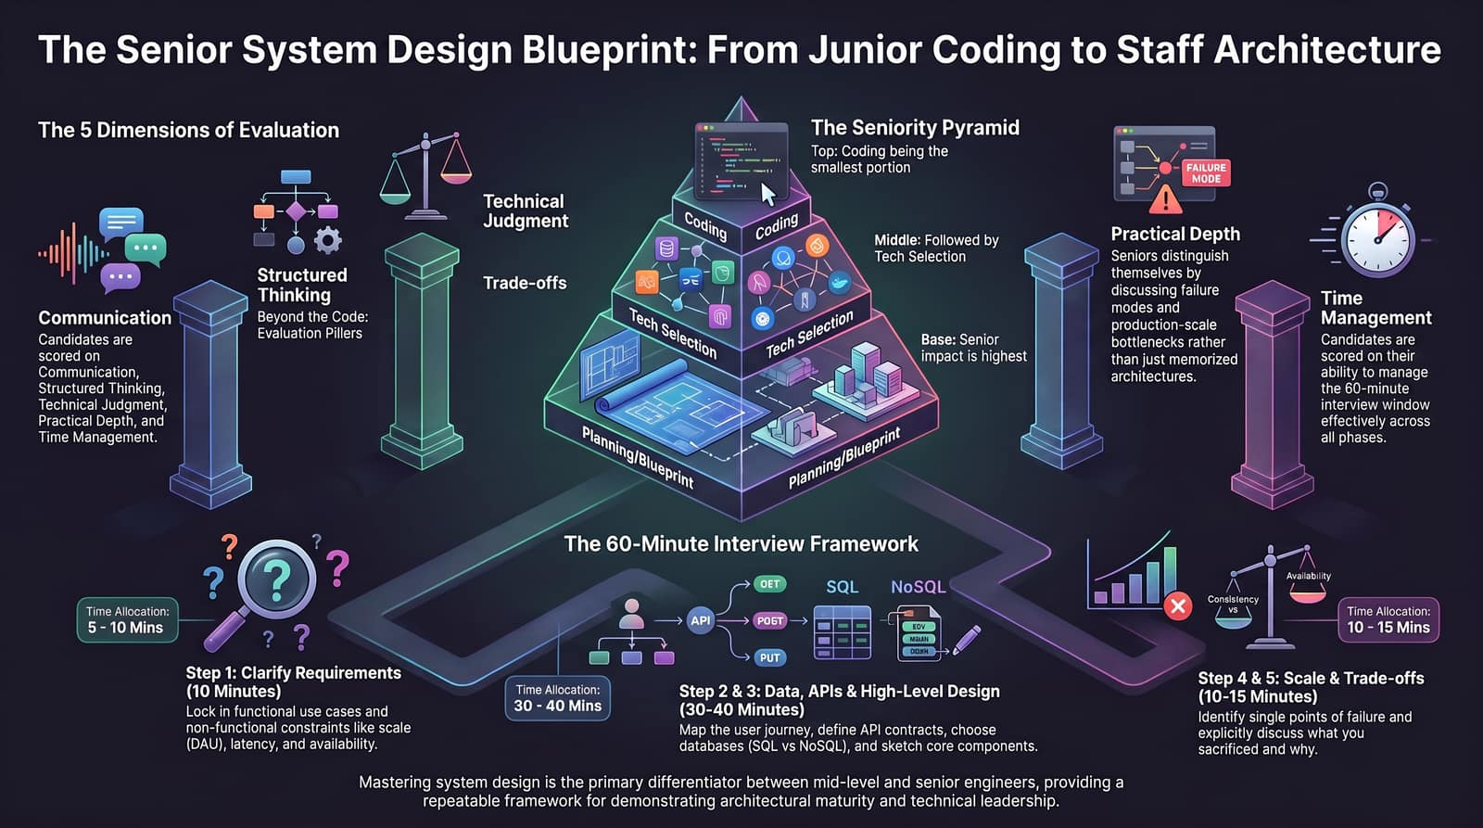
Notes:
To conclude our presentation, let's review the blueprint for mastering system design discussions and advancing your engineering career:
Structure Your Process: Always execute the 60-minute framework linearly. Clarify requirements upfront (10m), establish data/API contracts and high-level architecture (30–40m), then dive into scaling, bottlenecks, and failure modes (10–15m).
Focus on Evaluation Pillars: Focus on communication, structured thinking, and practical depth.
Embrace Production Realities: Senior impact is demonstrated by discussing edge cases, race conditions, single points of failure, and operational trade-offs rather than trying to present a 'perfect' theoretical architecture.
Thank you for your time, and I am now open to any questions!

